Slide 1

Europeana
Awareness Evaluation and Tracking Study – Italy wave 2
For Eleanor Kenny, British Library
By Simon McDonald I Business Director
simon@insites-consulting.com
Emma Hargreaves I Research Manager
emma@insites-consulting.com
Date June 14th, 2013
www.insites-consulting.com
Ghent I Rotterdam I London I Timisoara I New York

Slide 2

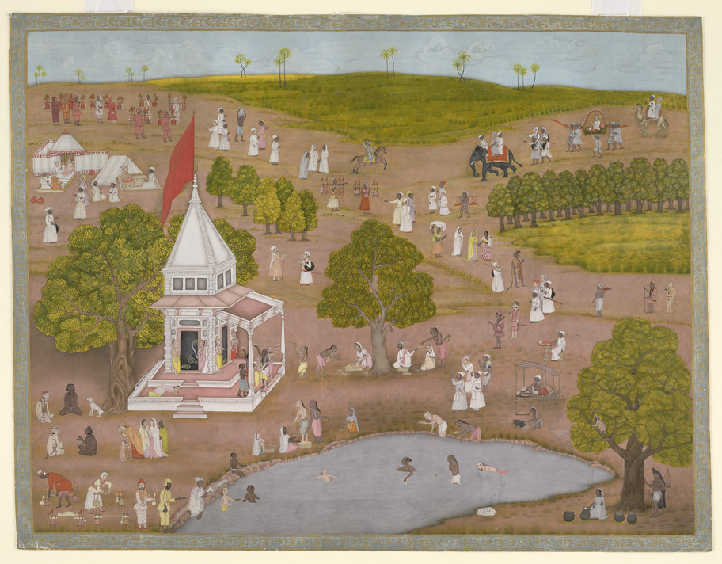

Agenda
Background & Objectives Overview
Method, Sample, Weighting
Awareness, Usage & Attitudes
Site Activation
Areas for Improvement
Q & A

Slide 3

Background & Objectives Overview

Slide 4
Background information
Europeana, Europe's “digital museum, library and archive” portal launched in 2008. The portal gives access to over 23 million cultural reference points such as films, books and museum objects contributed by over 2,000 European GLAMS.
PR campaigns have already been rolled out in some EU member states, and the programme will continue from 2012
One wave of research took place in March 2013 in Italy, Norway, Poland to to measure awareness, usage, and recommendation of Europeana at an early stage - before campaigns began and allow us to benchmark any future movements.
This study shows the results of research conducted May 2013 in Italy only
Background information

Slide 5
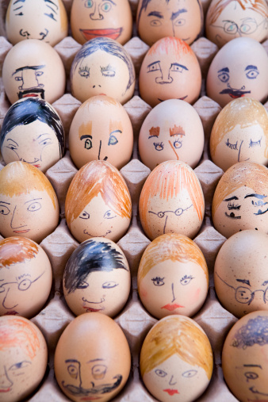
Method, Sample and Weighting

Slide 6
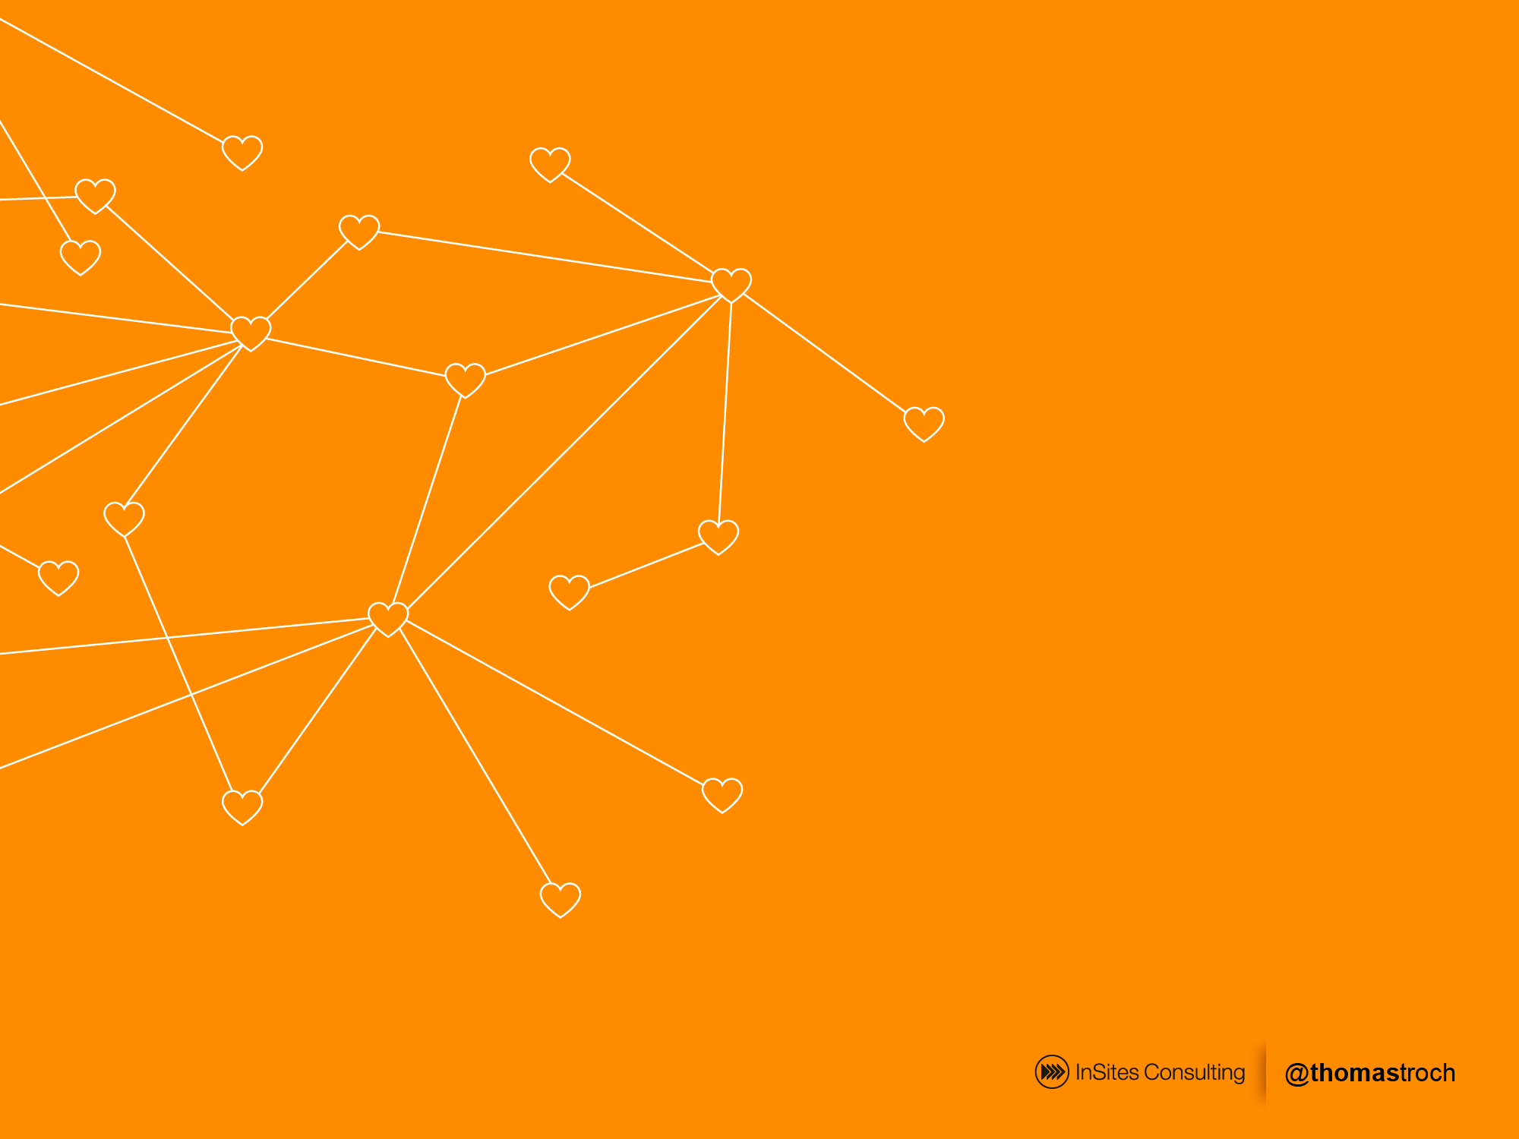



Wave one dipstick to measure awareness, usage, recommendation and attitudes to Europeana prior to marketing campaigns
Wave one
Poland
Italy
Norway
500 completed interviews in each market, March 2013
Quantitative
Online
Survey
Wave two
500 interviews in Italy, May 2013
Wave two in Italy only at the moment to measure changes in awareness, usage, recommendation and attitudes to europeana post marketing

Slide 7
Quantitative Study
Awareness and Usage
Screening
Activation
Screened for:
Interest in arts/culture/history
Visited museums, exhibitions, libraries, events in last six months
Allows for universe estimation
Awareness and usage of Europeana and competitive set
Likelihood to visit again and recommend
Source of awareness
Attitudes to Europeana
All respondents directed to Europeana and asked:
Attitude statements
Likelihood of returning/recommending
Likes/dislikes/suggestions

Slide 8
Summary – Wave One re-cap
Awareness is currently low – highest in Italy, lowest in Norway
Attitudes to the website are positive
Visits amongst those aware are high – visits amongst total population are low
But there are many opportunities to enhance the user experience
Norway is a challenge
Drive awareness through
  Chasing the promoters
  The internet as your friend
  Special features
Shore up repeat visits
  Design and navigation
  Be unique
  Be a curator, not an encyclopaedia

Slide 9
Sample - Screening
All respondents had to have:
Interest in arts/culture/history
Visited museums, exhibitions, libraries, events in last six months
 | Eligibility rates (wave one)
Italy | 60.4%
Norway | 46.9%
Poland | 73.1%
Total | 64.5% = 45.9m people
 | Unweighted screened sample | Weighted and grossed
Italy | 516 | 24.3m (52.9%)
Norway | 505 | 1.5m (3.3%)
Poland | 530 | 20.1m (43.8%)
Total | 1,551 | 45.9m people
All respondents weighted by age within country (W1 and 2)

Slide 10
Sample - Weighting
 | Unweighted screened sample | Weighted and grossed
Italy | 516 (33.2%) | 24.3m (52.9%)
Norway | 505 (32.6%) | 1.5m (3.3%)
Poland | 530 (34.2%) | 20.1m (43.8%)
Total | 1,551 respondents | 45.9m people

Slide 11
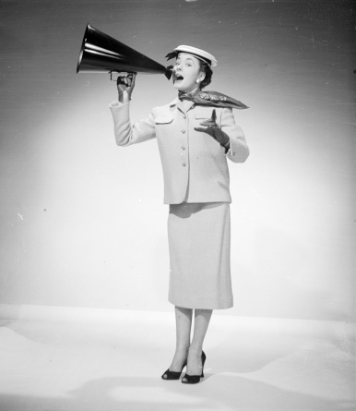
Awareness
Pre-activation

Slide 12


Overall Awareness of Europeana was low (wave 1)
Only 9% of all respondents are aware of Europeana
12%
Italy
4%
Norway
6%
Poland
12

Slide 13
Overall Awareness of Europeana - Italy
Awareness in Italy is the same in the second wave
12%
Italy (wave 1)
10%
Italy (wave 2)
13

Slide 14
Why has awareness not moved?
Statistically, there is no significant difference in awareness between wave one and two*
12%
+/- 3% gives a range of 9% to 15%
10%
+/- 3% gives a range of 7% to 13%
* At 95% confidence interval on sample of 500
14

Slide 15

Where has awareness changed?
Drop in awareness occurs amongst those:
only quite interested in arts
The youngest age group
The oldest age group
W2
W1
W2
W1
Very Interested in arts | 16% | 15%
Quite Interested in Arts | 2% | 8%
18-24 | 6% | 11%
25-34 | 19% | 19%
35-44 | 13% | 12%
45-54 | 6% | 8%
55+ | 6% | 12%
15

Slide 16
Why might this be?
Thoughts around awareness:
Wave one in Italy was highest of all countries, and may have already been high due to previous work (e.g. europeana fashion)
Need to address youngest and oldest groups
Those most interested in arts/culture being engaged through current activities
What does web traffic look like in Italy?
Awareness across other markets unknown – may increase overall score
16

Slide 17
Small increase in awareness of local sites
AIDED
AWARENESS
Objectives
W2
W1
Aware of europeana
Wikipedia
84% | 80% | 81%
52% | 52% | 74%
30% | 27% | 73%
10% | 12% | 100%
5% | 4% | 0%
Google Books
Google Art Project
europeana
None of these
MARKET SPECIFIC:
www.culturitalia.it = 26% (22%) 54%
www.san.beniculturali.it = 23% (19%) 48%
www.internetculturale.it = 19% (14%) 60%
Q8. Which of the following websites which contain art, museum collections, digitised books and cultural history are you aware of?
Base: All n=510 wave 2, n= 516 wave 1 for Italy

Slide 18



The internet currently plays a key role in the awareness of europeana
AWARENESS
SOURCE
Objectives
42%: search engine 39%: internet
34%: read/saw something in media 27%: social media
20%: library 17%: friends/colleagues
17%: leaflet/poster 15%: conference/exhibition
14%: museum
Brand fans – get those who know, use and like you to talk about you
Q11. How did you first become aware of the europeana website?
Base: All aware of europeana n=52

Slide 19

Website Usage
Pre-activation

Slide 20


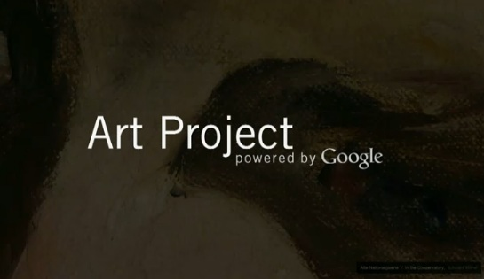
Usage amongst those aware is good. Over half of those aware have used Europena in the last month…
WEBSITE
USAGE
Objectives
PAST MONTH TOTAL
ITALY – WAVE 2
(ranked on past month total)
W2
W1
Awareness position W2
93% | 92%
77% | 65%
75% | 80%
74% | 73%
73% | 87%
72% | 71%
70% | 62%
1st
www.internetculturale.it
6th
2nd
www.culturitalia.it
4th
7th
3rd
www.san.beniculturali.it
5th
Q9. And which have you visited in the last six months at all? Please indicate when you last visited each site.
Base: Italy, aware of website
Wikipedia n=430; www.internetculturale.it n=96; Google Books n=265; www.culturitalia.it n=133; europeana n=52; Google Art Project n=152; www.san.beniculturali.it n=119

Slide 21
…but usage is low across the entire population
WEBSITE USAGE
TOTAL
Used in last 4 weeks
All respondents in Italy
Q9. And which have you visited in the last six months at all? Please indicate when you last visited each site.
Base: Italy all n=510

Slide 22
Future intended usage of europeana is still high amongst those aware
FUTURE
USAGE
Objectives
LIKELY TOTAL
ITALY – WAVE 2
(ranked total very/quite likely)
W2
W1
Current usage position
97% | 97%
94% | 91%
94% | 93%
93% | 83%
90% | 97%
88% | 90%
88% | 77%
1st
6th
3rd
www.internetculturale.it
2nd
www.culturitalia.it
4th
5th
www.san.beniculturali.it
7th
Q10. And how likely are you to visit each of these sites in the next six months? Please indicate for each site
Base: Italy, aware of website
Wikipedia n=430; www.internetculturale.it n=96; Google Books n=265; www.culturitalia.it n=133; europeana n=52; Google Art Project n=152; www.san.beniculturali.it n=119

Slide 23
Likelihood of using again is low amongst the general population (due to low awareness)
FUTURE USAGE
TOTAL
Very likely to use again in the next 6 months
All respondents in Italy
Q10. And how likely are you to visit each of these sites in the next six months? Please indicate for each site
Base: Italy all, n=510

Slide 24
Health check W2 v W1
Health Check
TOTAL
Objectives
 | Italy W2 | Italy W1
a) Awareness | 10% | 12%
b) Visited (last 4 weeks) | 7.5% | 10.4%
Conversion (b/a) | 75 | 87
c) Visited last 6 months | 9.0% | 11.8%
Conversion (c/a) | 90 | 98
d) Likely to visit again (ever) | 8.8% | 10.7%
Conversion (d/a) | 88 | 89
e) Very Likely to visit again | 6.5% | 7.4%
Conversion (e/a) | 65 | 62
f) Recommend | 8.6% | 8.5%
Conversion (f/a) | 86 | 71
Good conversion from awareness to visits, but drop off in comparison with W1
Drop off in very likely to visit again (attention to usability)
High levels of future recommendation – how to leverage the recommendations

Slide 25

Challenge to bring users back to the website
P*
Awareness is currently low
But conversion (usage) is competitive
Doesn’t always translate to future usage
* P=Position among europeana, Wikipedia, Google Books & Google Art Project i.e. those websites present in all markets
4th
2nd
3rd

Slide 26

Attitudes towards europeana
Pre-activation

Slide 27


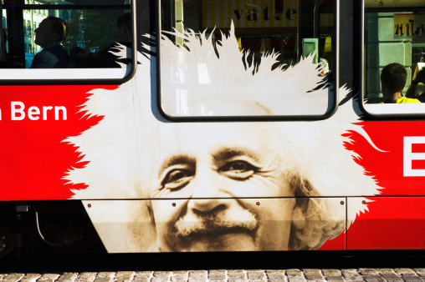
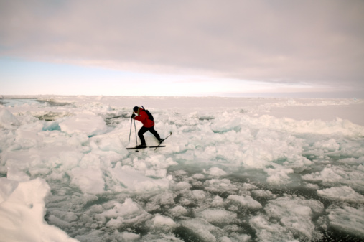
CURRENT STRENGTHS
EUROPEANA
Objectives
Wave 2 | Wave 1
36% | 42%
Wave 2 | Wave 1
41% | 40%
Wave 2 | Wave 1
40% | 43%
….a site where you can access millions of books, films, paintings and museum objects
…is an authoritative source of cultural information
provides a new way to explore the things I am interested in
Top box agreement with statement (totally agree)
Statements included here were the top strengths as identified at a total level in wave 1
BUT is europeana unique? 24% are unsure...
Q12, What have you heard about Europeana? Please answer each statement, saying how much you agree or disagree
Base: All aware of europeana n=118; Italy n=65; Norway n=18; Poland n=35

Slide 28
The europeana proposition is clearer to those who are aware of it in wave 2
CURRENT STRENGTHS
FUTURE
EUROPEANA
Objectives
AGREE
DISAGREE
W2
W1
W2
W1
Site with millions of books etc.
84% |  | 68% |  | 7% |  | 13%
83% |  | 72% |  | 9% |  | 9%
78% |  | 71% |  | 9% |  | 15%
73% |  | 68% |  | 7% |  | 9%
66% |  | 65% |  | 9% |  | 10%
Authoritative source
Recommendation
New way to explore
Can get the same somewhere else
Q12, What have you heard about Europeana? Please answer each statement, saying how much you agree or disagree
Base: Italy all aware of europeana. Wave 2 n=52; Wave 1 n=65

Slide 29
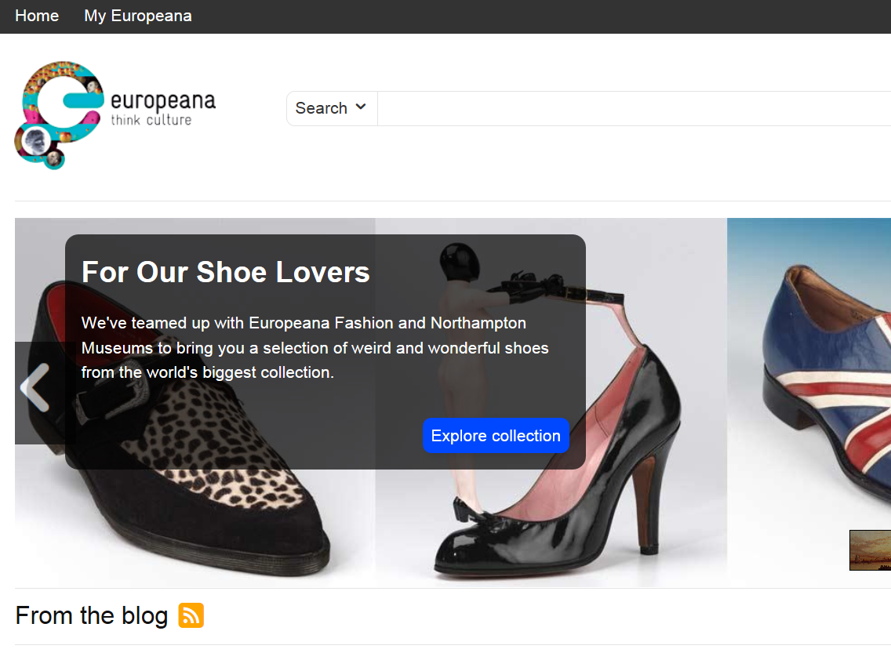
Activation
Survey directs participants to the webpage of europeana…
“Please take a few minutes to take a look at the website, and then come back to this window and answer the following short questions. “
Those already aware of europeana also take part in this task.

Slide 30
Attitudes towards europeana
Post-activation

Slide 31
There is a positive view of the site (before and after activation). Is the site unique?
FUTURE
WEBSITE
ACTIVATION
Objectives
SAMPLE WAVE 2
Pre-activation
(already aware)
Post-activation
(already aware)
Post-activation
(NOT aware)
Agree
Disagree
Agree
Disagree
Agree
Disagree
Site with millions of books etc.
84% |  | 7%
83% |  | 9%
78% |  | 9%
73% |  | 7%
66% |  | 9%
NA |  | NA
NA |  | NA
89% |  | 4%
91% |  | 2%
80% |  | 2%
77% |  | 2%
58% |  | 8%
77% |  | 8%
75% |  | 4%
60% |  | 4%
58% |  | 5%
60% |  | 10%
60% |  | 8%
54% |  | 6%
60% |  | 14%
51% |  | 12%
Authoritative source
Recommendation
New way to explore
Can get the same somewhere else
Easy to navigate
Find most things I wanted
Q13. Now that you have visited the Europeana website, please take a look at the statements below. Please answer each statement, saying how much you agree or disagree
Base: Italy already aware of europeana n=52; not aware n=458

Slide 32
Views of those not aware are similar in both waves
FUTURE
WEBSITE
ACTIVATION
Objectives
SAMPLE WAVE 2
Post-activation (NOT aware)
W2
W1
Agree
Disagree
Agree
Disagree
Site with millions of books etc.
60% |  | 4%
58% |  | 5%
60% |  | 10%
60% |  | 8%
54% |  | 6%
60% |  | 14%
51% |  | 12%
60% |  | 6%
63% |  | 4%
64% |  | 6%
62% |  | 8%
50% |  | 9%
62% |  | 11%
50% |  | 9%
Authoritative source
Recommendation
New way to explore
Can get the same somewhere else
Easy to navigate
Find most things I wanted
Q13. Now that you have visited the Europeana website, please take a look at the statements below. Please answer each statement, saying how much you agree or disagree
Base: Italy already aware of europeana W2 n=52; not aware n=458. W1 aware n=65; not ware n=451

Slide 33
Usage Intention
Post-activation

Slide 34
Future usage – increase in liklihood of visiting after reminding them of the site and its content
FUTURE
CURRENT USAGE
88% P6M
Objectives
P6M = Past 6 months
Pre-activation
(already aware) future usage
Post-activation
(already aware) future usage
LIKELY
UNLIKELY
LIKELY
UNLIKELY
88% |  | 12%
98% |  | 2%
Very | Quite
63% | 25%
Not very | Not at all
8% | 4%
Very | Quite
62% | 36%
Not very | Not at all
2% | 0%
Q9. And which have you visited in the last six months at all? Please indicate when you last visited each site.
Q10. And how likely are you to visit each of these sites in the next six months? Please indicate for each site
Q14. How likely are you to visit this site again in the future?
Base: Already aware of europeana n=52; not aware n=458

Slide 35
Future usage – those not aware are less likely, but still positive
FUTURE
CURRENT USAGE
95% P6M
Objectives
P6M = Past 6 months
Pre-activation
(already aware) future usage
Post-activation
(already aware) future usage
Post-activation
(NOT aware) future usage
LIKELY
UNLIKELY
LIKELY
UNLIKELY
LIKELY
UNLIKELY
88% |  | 12%
98% |  | 2%
77% |  | 23%
Very | Quite
63% | 25%
Not very | Not at all
8% | 4%
Very | Quite
62% | 36%
Not very | Not at all
2% | 0%
Very | Quite
32% | 45%
Not very | Not at all
19% | 4%
Q9. And which have you visited in the last six months at all? Please indicate when you last visited each site.
Q10. And how likely are you to visit each of these sites in the next six months? Please indicate for each site
Q14. How likely are you to visit this site again in the future?
Base: Already aware of europeana n=52; not aware n=1433.
Potential future users

Slide 36

What are people saying about europeana?
Post-activation

Slide 37


1. Interesting & useful content
“Seems like a very original and interesting site, it collects things that otherwise would be impossible to find on the Internet.”
LIKES
2. To seek information & to be informed – general or in relation to a specific event/exhibition etc.
3. To learn...to expand current knowledge or to explore the site in more detail.
4. Is detailed and complete with a wealth of information
5. Easy to navigate and search
Why are you likely to visit the site again? What made makes you want to come back?
Base: Very / quite likely to visit europeana again n=1166

Slide 38

1. Language issues/constraints
“For those unfamiliar with other languages, like me, it becomes a useless site.”
DISLIKES
2. User-freindliness - “Is not very intuitive”
3. Preference for other sites – “These are topics that interest me but I can find them elsewhere.”
4. Unclear & complex – “A little complicated compared to other sites, it takes more time to get results.” & “Seems too high class, built for academics.”
5. Layout & design – “Since the design is also a bit boring and does not invite me to further explore the site.”
Why are you not likely to visit the site again? What did you not like about the site?.
Base: Not very likely / not at all likely to visit europeana again n=385

Slide 39
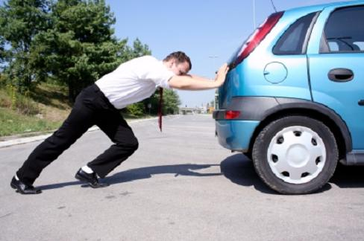
How to drive traffic to the site
Post-activation

Slide 40
DRIVERS
TO WEBSITE
Language
Objectives
1
Extend/complete translation
Graphics
2
Enrich & attractive
Navigation
3
Intuitive & transparent
Design
4
Visually sell yourself
Content and Curation
5
Enrich, expand & enhance

Slide 41
Language is a barrier to utilise the site, improved graphics will encourage repeat visits
DRIVERS
TO WEBSITE
Objectives
Language & translation
Graphics
The extent of the current translations is a barrier: translations are limited i.e. they do not extend to all functions/sections of the website.
Users commented that despite selecting their preferred language, majority of the information appears in English.
Some believed this was a fault, whilst others believe it makes the site unusable.
Demand to improve the graphics: current graphics appear unattractive and deters users from returning.
Graphics and images should be…
More appealing
Colourful & vivid
Higher in volume
Better quality
“It is accessible only to those who know the English language.”
“Certainly the graphics may be revised as currently they do not attract much and seem almost boring even for a person who visits the site for the first time.
“Although there is an option for the Italian language, it's only valid for the top menu, the rest is in English.”
“I found it a little scarce and unattractive ... maybe some nice artistic images may help.”
“It is not translated in Italian or maybe the translation is faulty.”
“More inviting images and more colour when it has to do with art. It did not look very creative.”

Slide 42
Navigation and user experience can be optimised through design, search and signposts
DRIVERS
TO WEBSITE
Objectives
Navigation
Design
Simpler, easier & clearer: current design means navigation is not intuitive.
Whilst the limited availability of translations will impact on ease of navigation, there is demand for a clearer understanding of content and topics on the site.
Overall need to simplify the navigation, making the site accessible to more users.
Exiting, colourful & inviting: opportunity to ‘delight’ users with improved content and homepage.
It’s not clear to everyone from the homepage, what to expect from the site.
Combined with improved graphics, users recommend improving the layout with clearer paths for navigation.
“More transparent site / clear message of what the page can offer me. The site is rather inaccessible.”
“Change the design and text so it becomes more obvious to the user.”
“Improved navigation - Intuitive.”
“A more user friendly summary of the content.”
“At the moment, the artwork does not attract my attention.”
“The site does not navigate well, there should be a index of topics.”
“It should be clear from the first click, what I can use the site for.”
“A more colourful site, better graphics.”

Slide 43
Be the curator. Direct and enhance through special features and refreshed content.
DRIVERS
TO WEBSITE
Objectives
Richer & more detailed: current content can be richer. Offering more text and images within the search results.
Recommendation to ensure content is refreshed, updated and always something new!
Special features appreciated.
Content and curation
“More search results and texts on a specific topic.”
“Several more of these special features would be nice.”
“More info, photos, maps, images, and deeper investigation.”

Slide 44

Who will help you promote the site?

Slide 45
Create an Advocacy Barometer
Advocates
Indifferent
Opponents

Slide 46
Advocacy Barometer – Take the opponents away from the advocates to give the barometer score
+54 All post activation
Advocates
Opponents
+100
0
-100

Slide 47
Advocacy Barometer – Chase the Promoters
+58
All v. int. in arts
+54
All post activation
Advocates
Opponents
+100
0
-100
+82
Used europeana before
+65
Aware google arts

Slide 48
Summary
Awareness is currently flat in Italy in comparison with the previous wave
Attitudes to the website are positive
Visits amongst those aware are high – visits amongst total population are low
But there are many opportunities to enhance the user experience
Drive awareness through
  Chasing the promoters and untapped potential
  The internet as your friend
  Special features
  Pay attention to the younger and older groups
  Are those with less interest part of your target?
Shore up repeat visits
  Design and navigation
  Be unique
  Be a curator, not an encyclopaedia

Slide 49
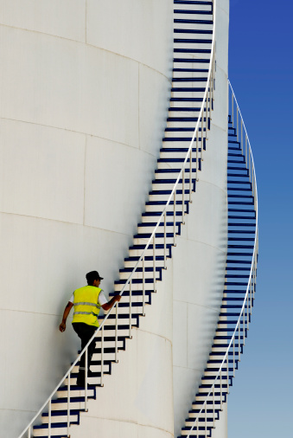
Next Steps
Digest and decide final deck/reporting format
Schedule wave 2 Fieldwork dates:
Poland
Norway
How to combine W2

